Slide 1
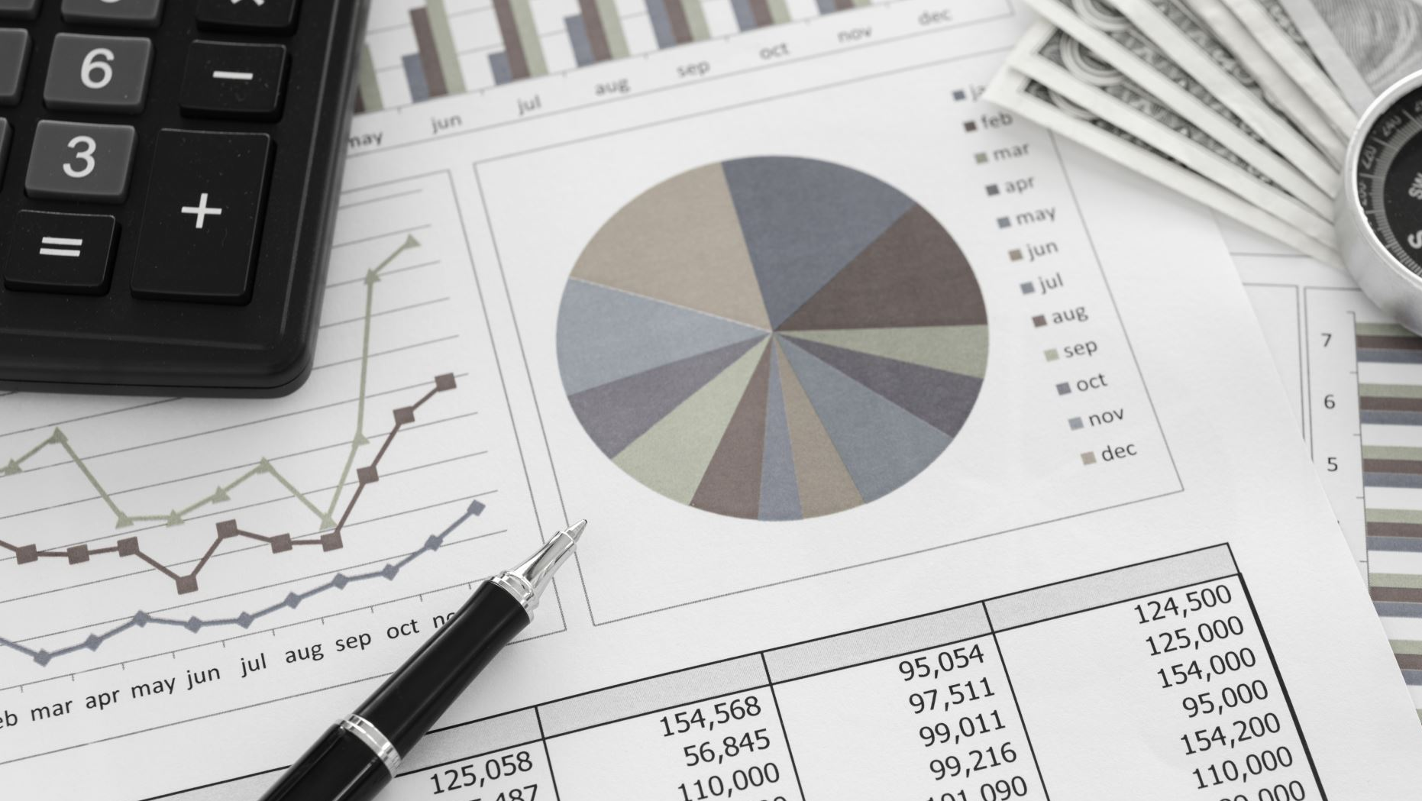
LOAN APPROVAL PREDICTION B . Sriharsha(507) Ch . Mahimavaidurya(515) A . Anish(506) A . Avinash Raj(505)

Slide 2
Agenda
INTRODUCTION
TYPES OF LOANS
OBJECTIVES
STEPS INVOLVED IN MACHINE LEARNING
DATASET SPECIFICATIONS
HARDWARE AND SOFTWARE USED
FEATURES
LOAN APPROVAL PREDICTION USING DECISION TREE
LOAN APPROVAL PREDICTION USING RANDOM FOREST CLASSIFIER
MODELS
ADVANTAGES
DISADVANTAGES
APPLICATIONS
CONCLUSION

Slide 3

INTRODUCTION
Loans are the core business of banks . The main profit comes directly from the loan’s interest. The loan companies grant a loan after an intensive process of verification and validation. However, they still don’t have assurance if the applicant can repay the loan with no difficulties. In our final year project, we built a predictive model to predict if an applicant is eligible for the loan or not. We prepared a model to predict the target variable.

Slide 4
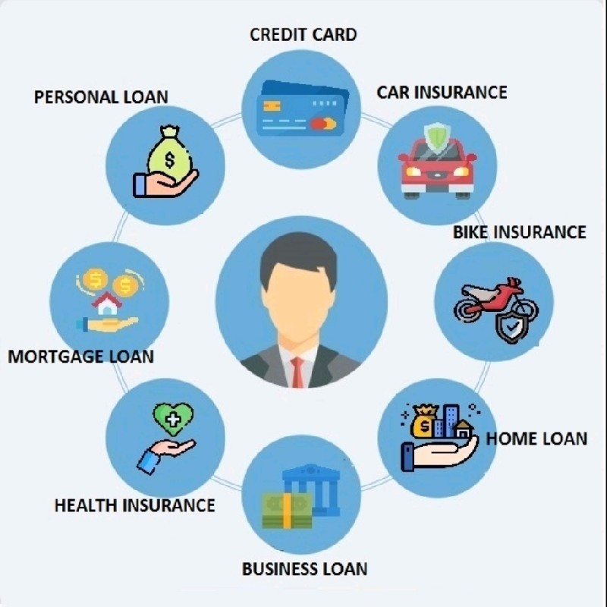
TYPES OF LOANS
Personal loan
Credit Card
Car Insurance
Bike Insurance
Home Loans
Business Loans
Health Insurance
Mortgage loans

Slide 5
OBJECTIVES
To make the process of loan approval easy using fewer resources and human resources.
To make the web apps which can be accessible by anyone on the internet without downloading any desktop software.
To make the prediction model which will make accurate predictions and help banks to make approving the loans very easy.

Slide 6
STEPS INVOLVED IN MACHINE LEARNING
1. DATA COLLECTION:
The quantity and quality of your data detect how accurate our model is .
The outcome of this step is generally a representation of data which we will use for training.
Using pre-collected data , by way of dataset from Kaggle still fits into this step.
2.DATA PREPROCESSING:
Wrangle data and prepare it for training.
Clean that which may require it(remove duplicates , correct errors, deals with missing values etc)
Randomize data which erases the effects of the particular order in which will collected and/or otherwise prepare our data.

Slide 7
STEPS INVOLVED IN MACHINE LEARNING
3. CHOOSE A MODEL:
Different algorithms are for different tasks; choose the right one.
4. TRAIN THE MODEL:
The goal of training is to answer a question or make a prediction correctly as often as possible.
Linear regression example: Algorithm would need to learn values for m (or W) and b(x is input, y is output).
Each iteration of process is a training step.

Slide 8
STEPS INVOLVED IN MACHINE LEARNING
5.Evaluate the model:
Uses some metric or combination of metrics to measure objective performance of model.
Test the model against previously unseen data.
This unseen data is meant to be somewhat representative of model performance in the real world, but still helps tune the model.
Good train/ evaluate split 80/20, 70/30, or similar, depending on domain, data availability, dataset particulars etc.

Slide 9
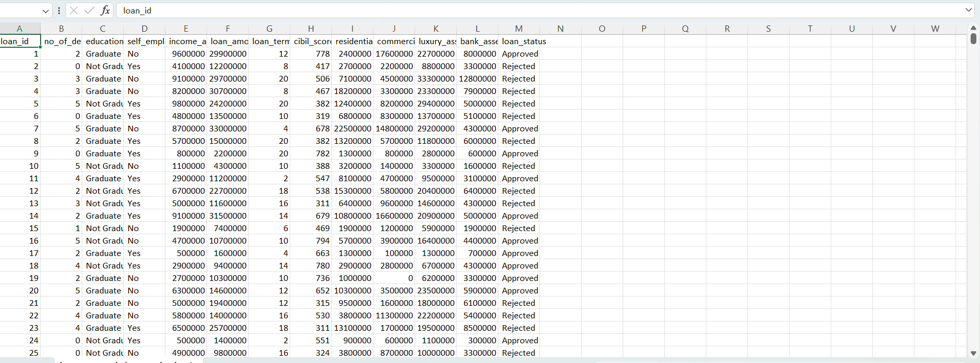
DATASET SPECIFICATIONS
To predict loan approval, we need to gather data on applicants loan id , No of dependents, Education , Self Employed, Income Annum, credit score, residential assets , commercial assets, loan status, loan term and relevant factors.
The outcome of dataset is represented by loan status in the train dataset

Slide 10





HARDWARE AND SOFTWARE USED
HARWARE USED:
Computer Windows
SOFTWARE USED:
Jupyter notebook
VS Code
LANGUAGES USED:
Python 3
LIBRARIES:
Pandas
Numpy
Seaborn
Matplotlib
Sklearn

Slide 11
FEATURES
Loan _ID: The ID number generated by the bank which is giving loan.
Dependents: family members who stay with the person.
Education: Educational Qualification of the person taking loan.
Self _ Employed: whether the person is self _employed or not.
Applicant Income: The basic salary or Income of the applicant per month.
Loan Amount: The amount of loan for which loan is applied.
Loan _ Amount _ term: How much time does the loan applicant take to pay the loan.
Cibil _Score: Cibil score of the applicant.
Loan _ status: Status of the loan(Approved/Rejected)

Slide 12

LOAN APPROVAL PREDICTION USING DECISION TREE
DECISION TREE:
Decision trees are a nonparametric supervised learning method used for classification and regression. The deeper the tree, the more complex the decision rules and the fitter the model. Decision tree uses the tree representation to solve the problem. In which each leaf node corresponds to a class label and attributes are represented on the internal node of the tree. The primary challenge in the decision tree implementation is to identify the attributes. There are two popular attribute selection measures they are Entropy and Gini index. Entropy is the measure of uncertainty of a random variable, it characterizes the impurity of an arbitrary collection of examples. The higher the entropy more the information content.

Slide 13
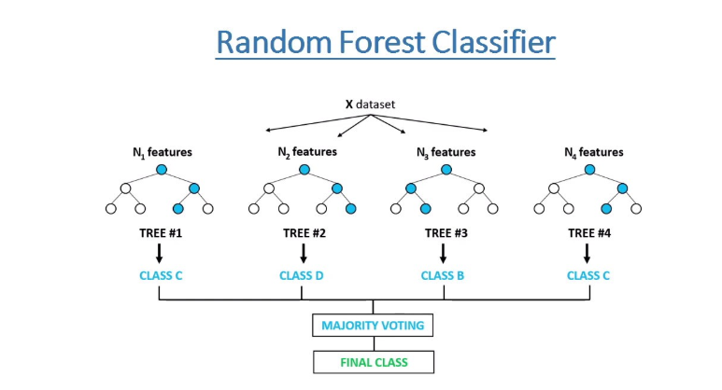
LOAN APPROVAL PREDICTION USING RANDOM FOREST CLASSIFIER
RANDOM FOREST CLASSIFIER:
Random forest is one of the most popular algorithms in most use cases / projects across industries. Its fast, easier to implement, needs lesser data, doesn’t require extensive training and produces almost equally good results.
Again, because so many API libraries exist for several machine learning algorithms, the code for all simple machine learning algorithms is straightforward.

Slide 14
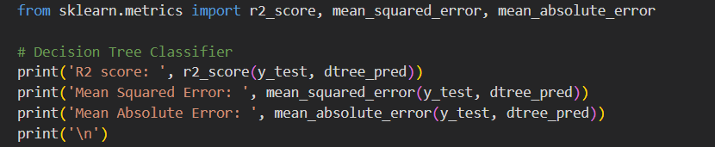
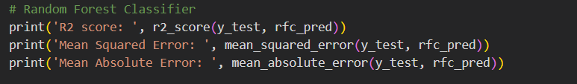


MODELS

Slide 15
ADVANTAGES
Efficient Decision making
Risk Management
Improved Customer Experience
Reduced Manual Work
Cost Savings
Fraud detection

Slide 16
DISADVANTAGES
Bias and Fairness Concerns
Data Quality Issues
Lack of Human Judgment
Privacy Concerns

Slide 17
APPLICATIONS
Credit Scoring
Personalized Offers
Portfolio Management
Continuous Improvement

Slide 18
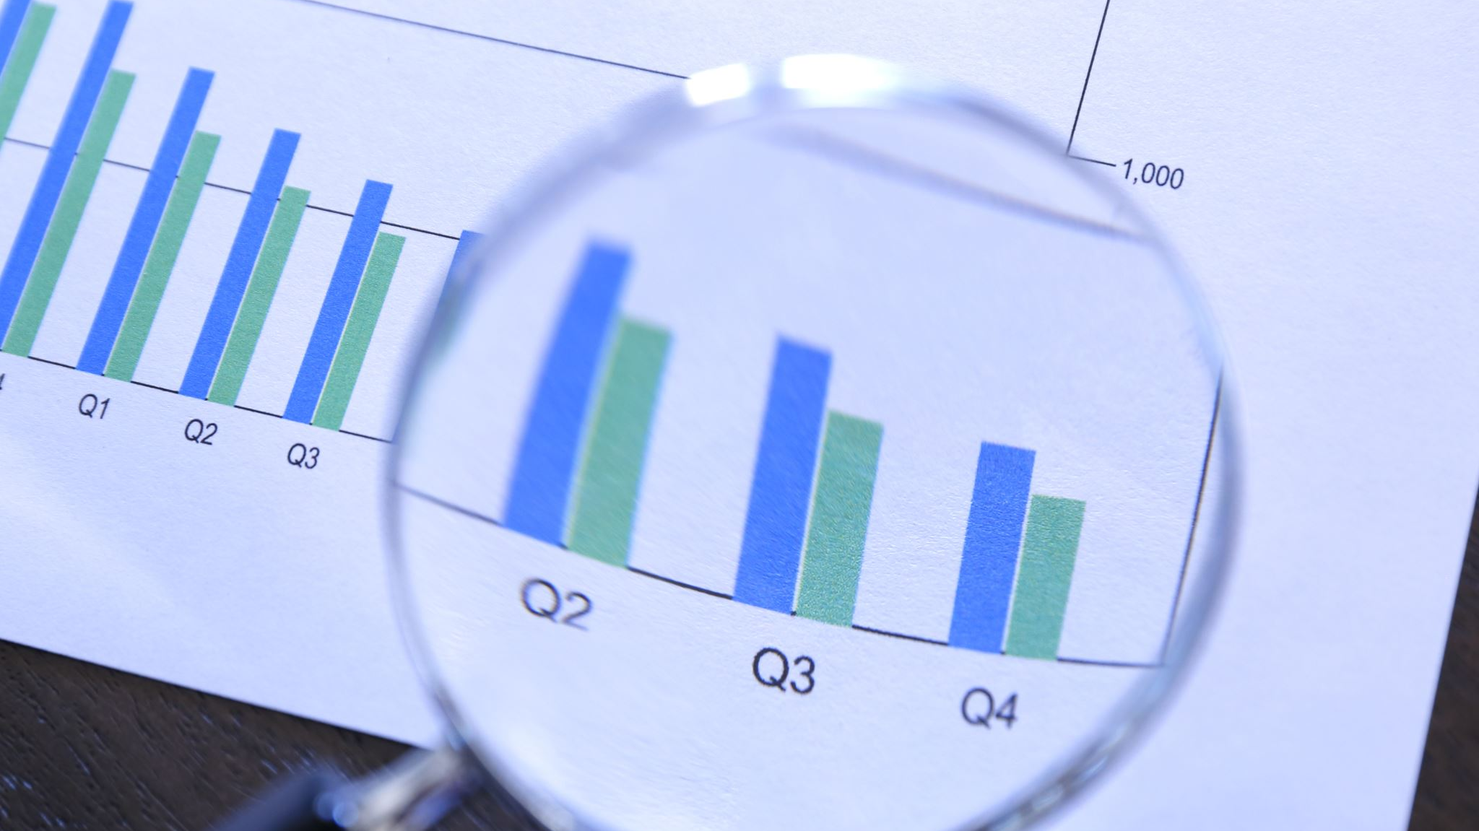
CONCLUSION
From the exploratory data analysis, we can conclude that the following factors are important for the approval of loan:
CIBIL Score: People with higher CIBIL score have higher chances of loan approval.
Number of Dependents: People with greater number of dependents have less chances of loan approval Assets: People with more assets (including movable and immovable) have higher chances of loan approval
Loan Amount and Tenure: People with higher loan amount and lower tenure have more chances of loan approval.
Coming to the machine learning models, I have used Decision Tree Classifier and Random Forest Classifier. Both the models have given excellent results having accuracies - 91.4 % and 89.4 % respectively. But the decision tree classifier has yielded better results than the random forest classifier.

Slide 19

THANK YOU

